Slide 1
SECURE DATA HIDING IN IMAGE USING STEGANOGRAPHY
CAPSTONE PROJECT
Presented By
Student Name : Aanchal Yadav
College Name : Sushila Devi Bansal College of Engineering
Department : Computer Science and Engineering

Slide 2
OUTLINE
Problem Statement
Technology used
Wow factor
End users
Result
Conclusion
Git-hub Link
Future scope

Slide 3
Problem Statement
In the digital age, securing sensitive information during transmission and storage is a critical challenge.
Traditional encryption methods make data conspicuous, attracting potential attackers.
Steganography offers a covert approach by embedding secret data within images, ensuring confidentiality
without raising suspicion.
This project focuses on developing a secure and efficient image steganography technique
to hide and retrieve data while maintaining image quality and robustness against attacks.

Slide 4


Technology used
Python 3.12.4 – Core programming language used
OpenCV (cv2) – Image processing and manipulation
Steganography (LSB Method) – Hiding secret messages in images
File Handling – Storing and retrieving passwords securely
Command-Line Interface (CLI) – User interaction for encoding/decoding
This Photo by Unknown Author is licensed under CC BY-SA-NC
This Photo by Unknown Author is licensed under CC BY-SA-NC

Slide 5
Wow factors
Invisible Message Encoding – Hides secret text inside an image without noticeable changes.
Password-Protected Steganography – Ensures only authorized users can decode the message.
No External Libraries (Except OpenCV) – Lightweight and easy to use with minimal dependencies.
Fast & Efficient – Quick encoding and decoding process using pixel manipulation.
Lossless Image Steganography – Uses PNG format to prevent data loss during storage.
Practical Cybersecurity Application – Demonstrates real-world steganography techniques used in
cybersecurity.

Slide 6
End users
Cybersecurity Professionals – To understand and analyze steganography techniques used in data hiding.
Forensic Experts – For investigating hidden messages in digital images.
Researchers & Students – To study information security and steganography applications.
Journalists & Whistleblowers – For secure communication and protecting sensitive information.
Developers & Ethical Hackers – To experiment with and improve steganography methods.

Slide 7
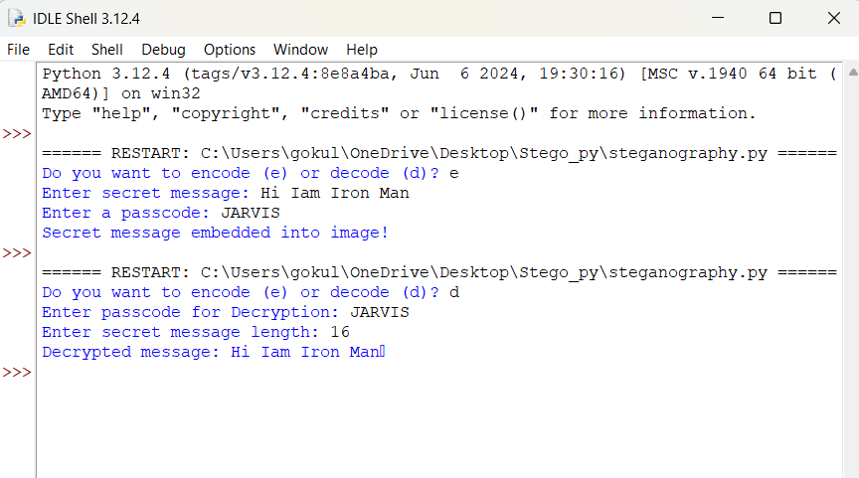
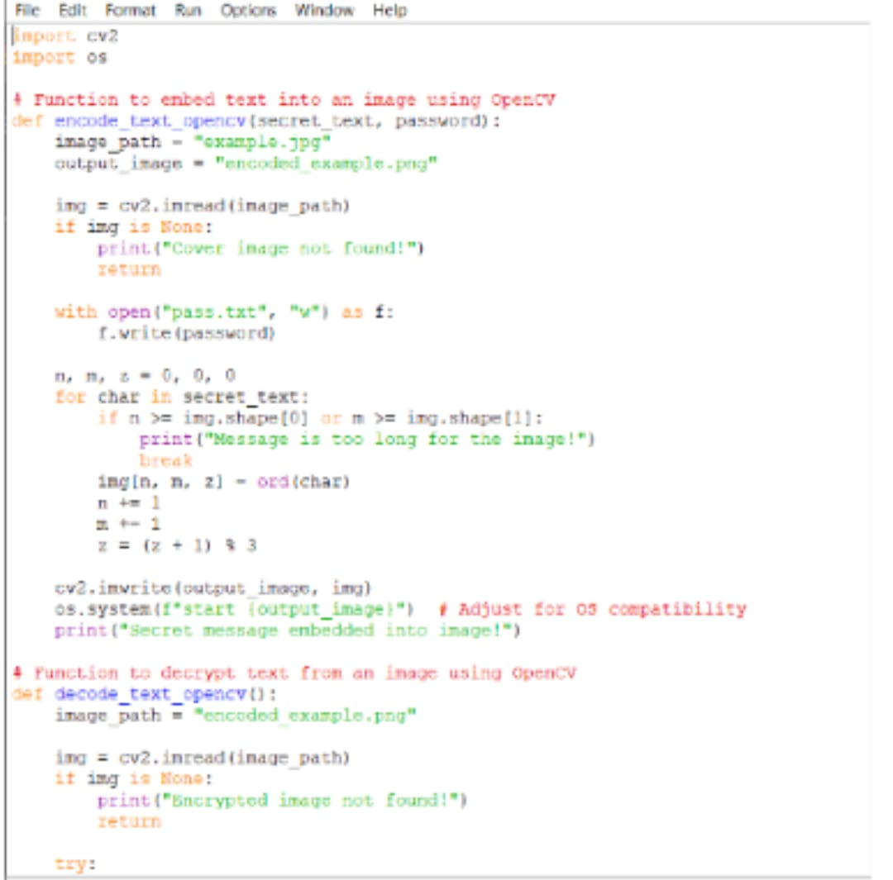

Results
Console Output:
Python program:
Project files:

Slide 8
Conclusion
This project demonstrates a simple yet effective implementation of image steganography using the Least Significant Bit (LSB) method.
By embedding and retrieving secret messages within images, it highlights the importance of data hiding techniques in cybersecurity.
The use of OpenCV ensures efficient image processing, while password protection adds an extra layer of security.
This project serves as a foundation for further research and development in secure communication, digital forensics, and information security.

Slide 9
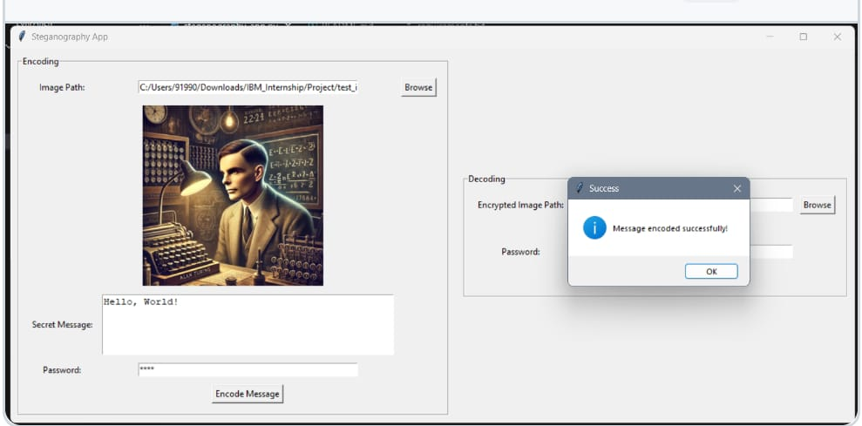

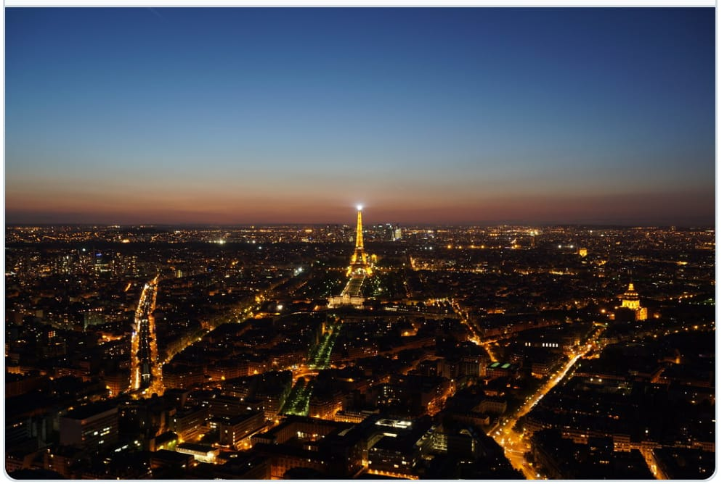
ENCODED IMAGES

Slide 10


GitHub Link
https://github.com/aanchalyadav1/SECURE-DATA-HIDING-IN-IMAGE-USING-STEGANOGRAPHY
This Photo by Unknown Author is licensed under CC BY-NC

Slide 11
Future scope(optional)
Offensive Security: We can embed payloads and scripts into normal images, enabling more sophisticated
social engineering attacks.

Slide 12
THANK YOU

